Slide 1
Introduction to The Periphyton Roof A Regenerative Technology
An Energy Saving Building Envelope Featuring Meaningful Regenerative Aquatic Ecosystem Impacts
System Features:
Nutrient Removal, Oxygenation, CO2 Uptake, Heavy Metal Uptake, Water Purification, Aquatic Organism Water Conditioning, Soil Bank Fortification and Nutrient Removal Trading Credit Revenue

Slide 2
Let me introduce you to the Star Of The Show….. Periphyton!
“Algal Turf’s are fantastic consumers of nutrients and can produce single digit PPB concentrations for N and P. As Algae consume CO2, pH raises and this causes co-precipitation of nutrients on to the cell walls where they are metabolized.” Walter Adey PhD. Smithsonian MSL
“Periphyton are Primary Producers and a great solution for water filtration.” Howard T. Odum PhD. Emergy Studies Laboratory U FL….widely regarded as one of the fathers of Modern Ecology “Kyle, Algae are amazing organisms that can be used effectively in water treatment.” William Oswald PhD. UC Berkley EEHSL

Slide 3
¼ Acre Periphyton Filter, Patterson CA. Textured 60 mil HDPE Landfill Liner on soil with Precast Grade Beams Bio Environmentals Inc. project in conjunction with Smithsonian MSL, UC Berkeley EEHSL , funded by Donald Panoz ABES Chateau Elan
San Joaquin River
City of Patterson CA Waste Water Treatment Plant Evaporation Basin

Slide 4
Climax growth on the Patterson Periphyton System Treated Waste water resulted in the highest ever yield for a Periphyton Filter yielding over 1,600 lbs. P/acre/yr. production rates topped 30 g dry/day with P concentrations up to 2.5%. Current P Credit Value in some US regions is over $500 per lb.

Slide 5
Patterson Periphyton Filter Harvester Bio Environmentals Inc. Vacuum Harvester driven by a Ford Straight 6. 22’x500’’ Floway was harvested in 4 passes. Biomass used wet to spray fallow fields, hydro seed bare soil, dried and used dried for viticulture research

Slide 6
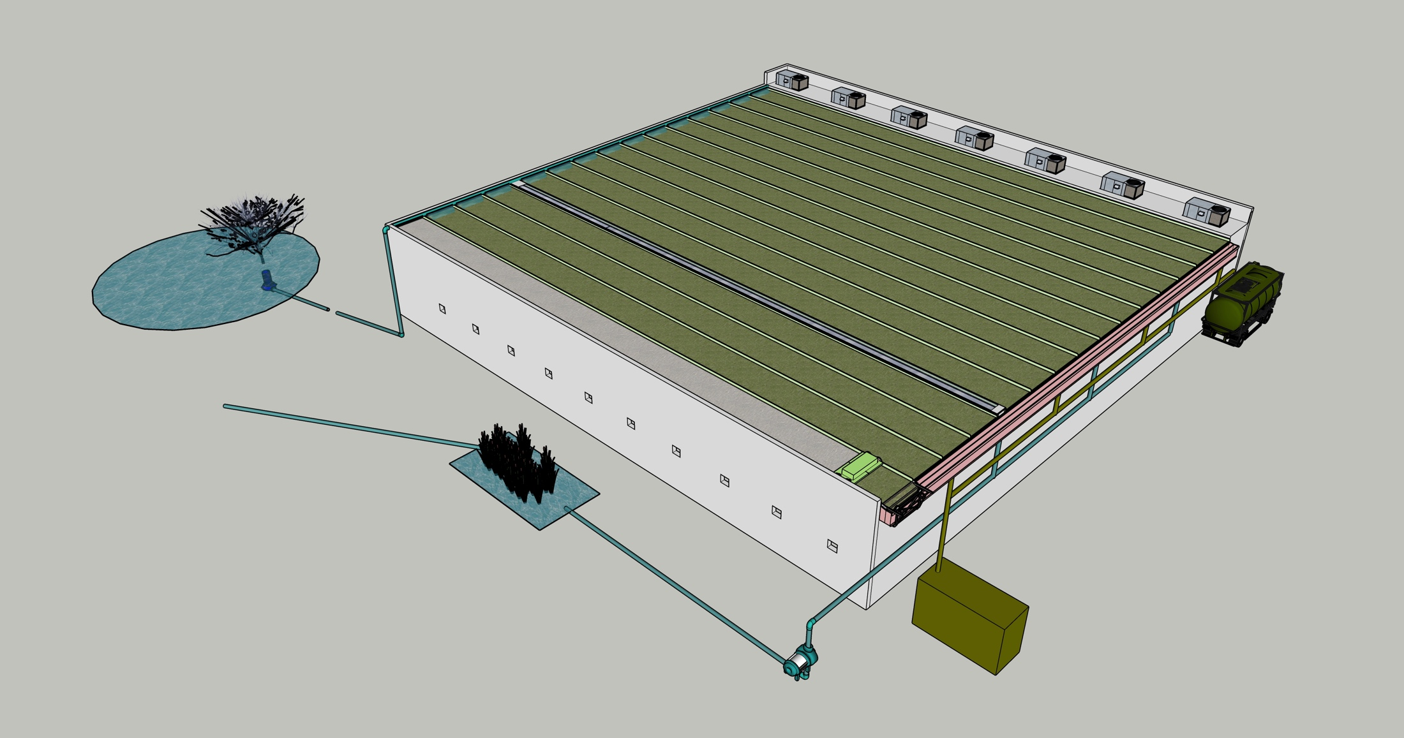
Why Do this? The 1” deep water attenuates almost all of the Suns heat energy effectively shading the roof. The outflow water is filtered and that nutrient removal is worth $ An Overview:
Water Delivered to Roof at 1 GPM/LF width
Showing 15–5’ Floways but can be unlimited and 500’ + in length
Roof Top Equipment can be accommodated at the perimeter of the sides or High Side of the Roof
Inflow Water Source
Usually a Fore Bay or Pumping Basin to a Lake , Pond or River
Skylights can be accommodated between Floways
Harvest Trailer Spreader
Pump
Water is returned to the basin in a greatly improved condition
Robotic Harvester
By Team Wyachi
2 Cell Gutter
Filtered Water Outflow Piping
Passive outflow Screening and Polishing Systems provide Outflow stability and redundancy
Harvester Indexing Trolley
Dewatered Biomass Piping System
We Prefer High Fixed Glazing VS Skylights if possible.
Electrical Recovery Turbine
Biomass Vault

Slide 7
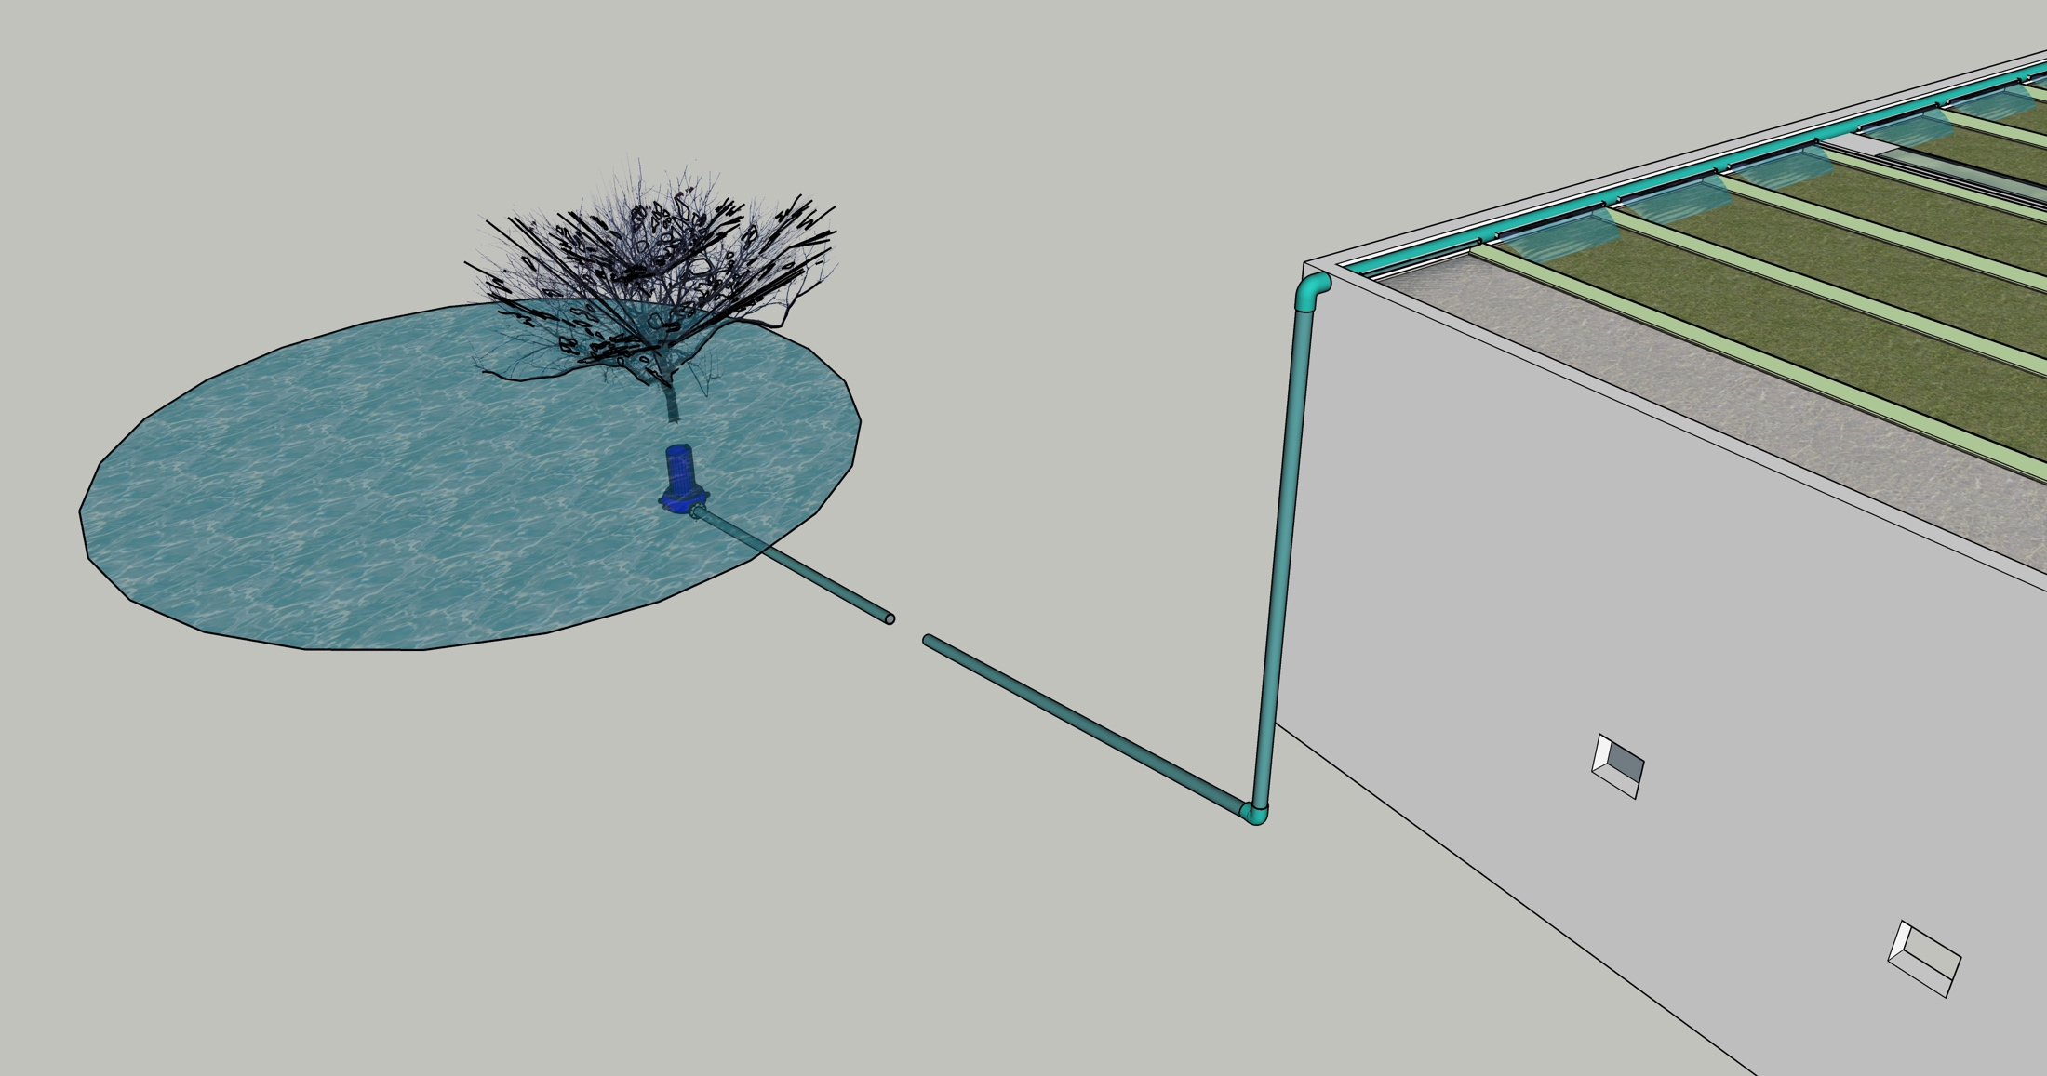
The Water Inflow Side
Some Ecosystems with high Avian loading can benefit from the intake water being situated near a Roosting Armature.
Water is delivered to the High Side and flows over Periphyton Cultures to the Low Side on a slope of 12”/100’. The Roof is designed to never be capable of flooding.
Water for a Periphyton Roof needs to come from a Lake or River with a volume roughly 10x the Flow.
Easy to replace Submersible Pumps are desirable for cool running and flooded Suction
Various methods can be used to eliminate micro grazing organisms in the Inflow stream. This can extend harvest intervals and improve performance.

Slide 8
Roof Top Equipment Needs
HVAC Units are accommodated on the High Side or either sloped Sides of the Roof

Slide 9
Skylights and other Roof Penetrations are doable with precise execution but I discourage them. Design details are critical and must allow for full sealed linear thermal expansion which can be challenging and expensive on longer distances. Thermal expansion of the Roof Slab is also an area of careful consideration in design and detailing.

Slide 10
Harvesting Periphyton Prior to harvesting, the Periphyton Culture is drained for 1-2 hours to dewater the biomass
I work with Team Wyachi Robotics on the design and fabrication of Periphyton Harvester Systems. Wyachi has extensive robotic experience and is a global leader in Robotic competition.
Periphyton Algae Squeegeed off the culture surface, over the Harvest Chute, into the Biomass Gutter
Low Voltage Leak Detection System
Harvest Carriage
2 Cell Gutter

Slide 11
2 Cell Gutter
Sika Sarnafil Custom Rib Extrusion
A 2 Cell Gutter allows water to flow in the Floways not being harvested. The Harvest Chute is deployed by the Carriage after the culture is dewatered to convey Biomass from the Floway into the Biomass Gutter. The Harvest Carriage has a Scraper, not shown, that conveys biomass in the Harvest gutter to the Harvest Drain Pipes.

Slide 12
Harvester On Carriage in Indexing Mode with Squeegee Raised and Chute Retracted

Slide 13
Sika Sarnafil “Dacor Profile #0331 Sika is a widely used premium roofing system. The textured version of this product was tested in situ for 3 years in Periphyton Culture with no discernable wear. Algal biomass is a natural lubricant so harvesting is gentle on the membrane. Biomass and water shades the roof from UV almost all the time. At the time of this testing Sika was optimistic they would warranty the Roofing system in this application. A Custom Batten must be extruded for the Periphyton Roof Floway separation.

Slide 14
Articulated Harvest Transfer Chute
The Harvester Carriage has an Articulated Chute that is deployed on a dewatered Floway to convey the dewatered biomass over the treated water outflow.
Filtered Water Cell
Biomass Cell

Slide 15
Periphyton Roof Use Parameters And Operational Requirements
Size and Slope: Can work at any scale but generally, for meaningful surface water improvement, larger flat Roofs greater than .25 acres (10,000 SF) are viable. Steeply sloped Roofs can be designed with consideration for harvesting and splashing during wind events.
Location and Terrain: Climate Region Tropical to Semi Tropical for full year operation. Can be used in northern climates on a seasonal basis. Roofs can be quickly and easily shut down and restarted. If a user wants to stop operations at anytime the system is simply shut off.
Water Type: Water Systems need to be large enough to not be nutrient limited or impacted by heat from Summer day operations. Water Temperature is always limited by evaporative cooling. Salt and Brackish water sources work as well.
Inflow and Outflow Systems Management : Inflow systems, if required are focused on controlling on micro invertebrates that can limit Periphyton System performance through grazing. These systems are designed to be largely passive but do require occasional maintenance. Outflow system such as managed wetlands, artificial substrate non harvested Periphyton systems and sand filters are all passive but have occasional maintenance requirements.
Harvesting: The system can actually be operated with out harvesting but looses the 100X performance advantage over terrestrial wetlands. Harvesting is done nocturnally. Optimal Harvest interval will vary from 1 week to 1 month and will be affected by season, water system variability.
Biomass Disposal and Use: This is up to the users and largely governed by the local opportunities. Transportation of wet biomass over distance is expensive. Viable uses investigated: Paper-Algae pulp molded packaging, hydro seeding grass and flowers, flood irrigation of crops, vines and trees, sod production, agricultural amendment, animal feed alone and with additives, fine chemical manufacturing.
Maintenance: The harvester requires periodic maintenance and there are Pump (s) and Piping systems and valves to maintain. A automated 1 acre system could easily be maintained by 20 man hour effort a week.

